Slide 1
Asymmetric Encryption
By Sarang Patel

Slide 2
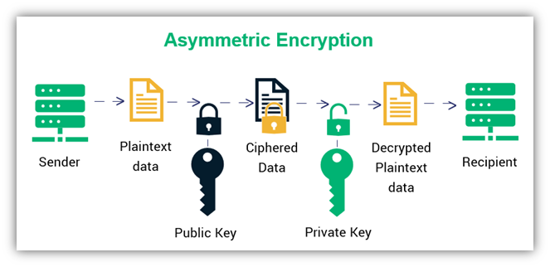
How it works

Slide 3

Uses

Slide 4

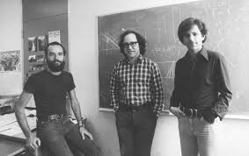
History
Proposed in 1976
Implemented in 1977
Whitfield Diffie and Martin Hellman
Adi Shamir, Leonard Adleman, Ronald Rivest

Slide 5
Advantages/Disadvantages
Advantages
Increased security
Digital signatures
Non-repudiation
Disadvantages
Slow
Not effective for bulk text
Lost private key = Lost message
Public key/private key can be stolen

Slide 6
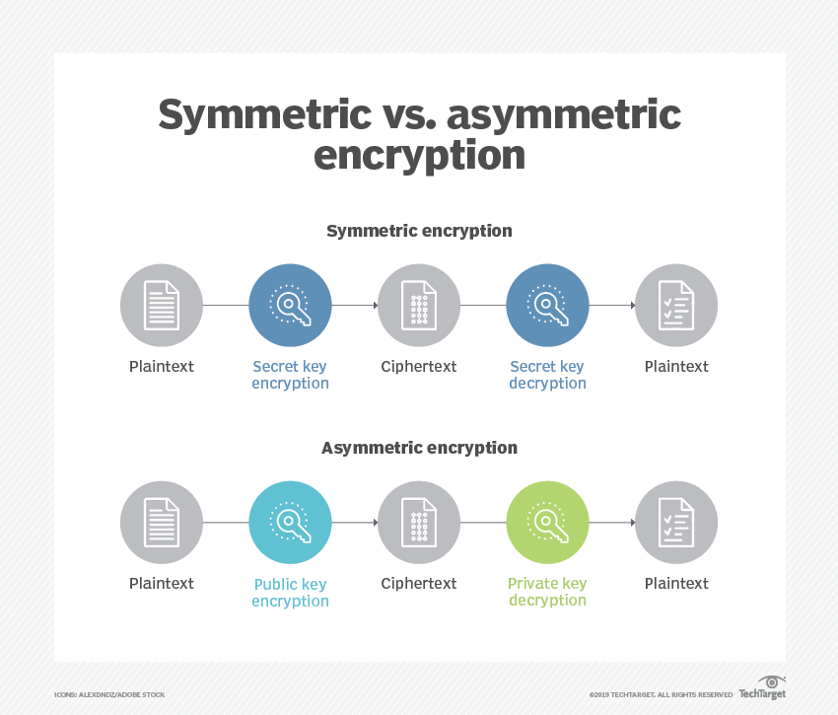
Alternative

Slide 7
References
https://www.theatlantic.com/magazine/archive/2002/09/a-primer-on-public-key-encryption/302574/
https://ghostvolt.com/articles/cryptography_20th_centuary.html#:~:text=The%20RSA%20algorithm%20for%20asymmetric,encryption%20algorithms%20have%20been%20invented
https://www.keyfactor.com/blog/symmetric-vs-asymmetric-encryption/
https://www.techtarget.com/searchsecurity/definition/asymmetric-cryptography
https://www.acm.org/articles/bulletins/2016/march/turing-2015-diffie-hellman
https://cryptologicfoundation.org/what-we-do/educate/bytes/this_day_in_history_calendar.html/event/2020/09/20/1600578000/1983-three-inventors-receive-patent-for-encryption-algorithm-rsa/78258

